Slide 1
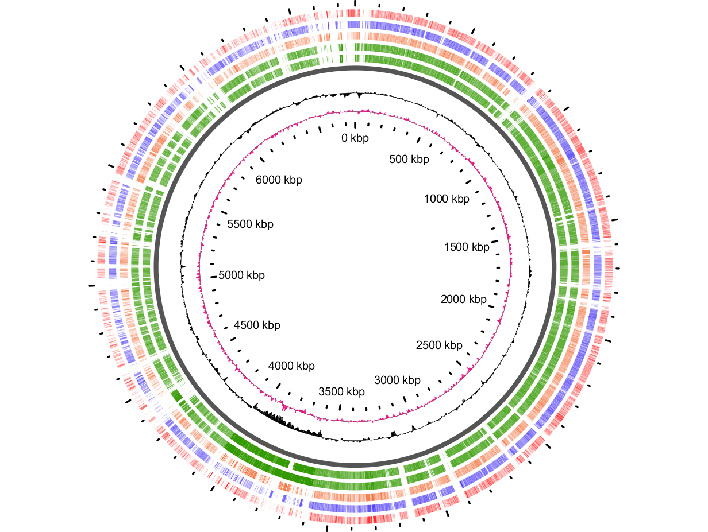
CHR2 (chromid)
CHR1
F
I
H
E
A
B
C
J
G
L
K
D
pSym

